Slide 1
Fairfield City Open Libraries Spotlight on Multicultural Services
Supporting a CALD community

Slide 2
Fairfield City Acknowledgement of Country
Fairfield City Council acknowledges the Cabrogal of the Darug Nation as the traditional custodians of the Fairfield Local Government Area and pays its respects to its Elders both past, present and emerging.

Slide 3
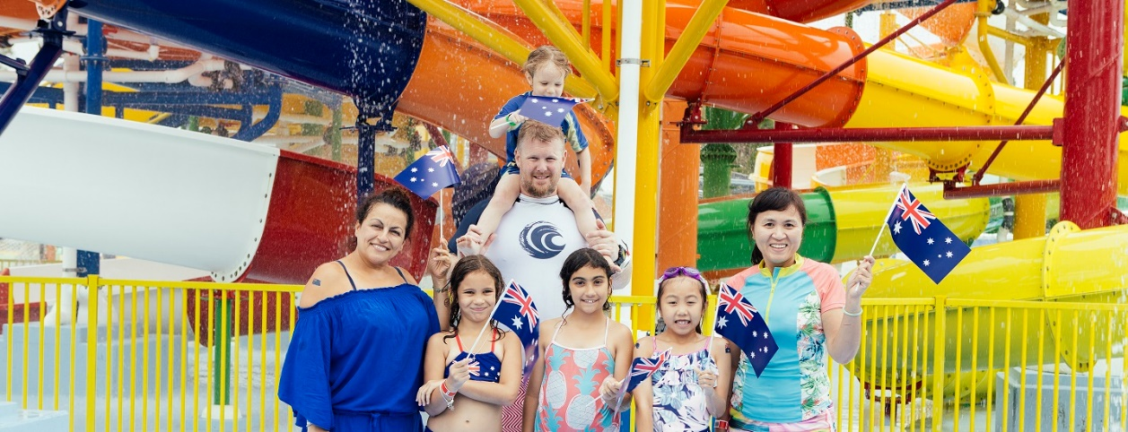
Fairfield
A unique and diverse city
Fairfield City is renowned for the cultural diversity of its residents and uniqueness within the Sydney metropolitan area.

Slide 4
Fairfield
A unique and diverse city
History of the Fairfield City District does not emanate from the simple, single set of circumstances like the beginnings of many settlements in the New South Wales colony. Instead Fairfield's foundation arose from a number of factors, with each region of the district having its own story.
The development of the City was influenced by both the fortunes of chance and the result of planning. The people who came to settle the area were extremely diverse and represented every rank and station of the Colony
The City is serviced by two rail routes, is conveniently accessible to all the major highways.

Slide 5
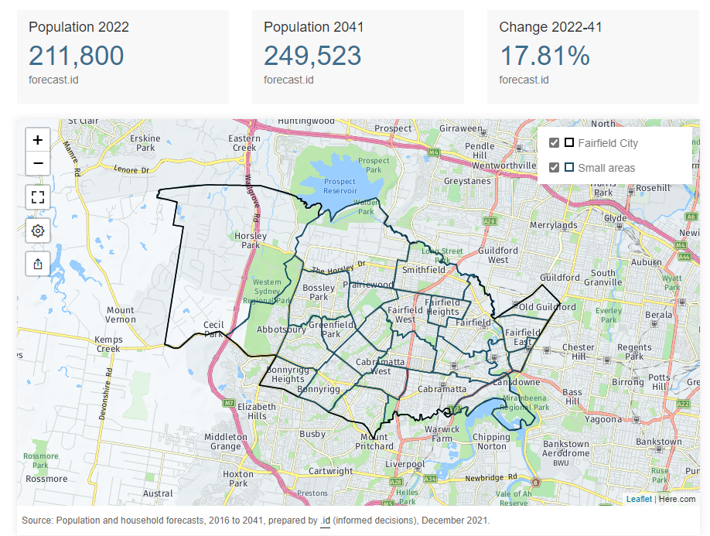

Slide 6
Fairfield
A unique and diverse city
Fairfield City is located in Sydney’s south-west and is predominantly residential, with substantial industrial and commercial areas, and some rural residential areas in the west.
56.0% of people in Fairfield City were born overseas and is an indicative of the level of cultural diversity, when compared with 38.6% in Greater Sydney. (Census 2021)
69.7% of people spoke a language other than English at home, closer to 80 different languages spoken in the LGA

Slide 7
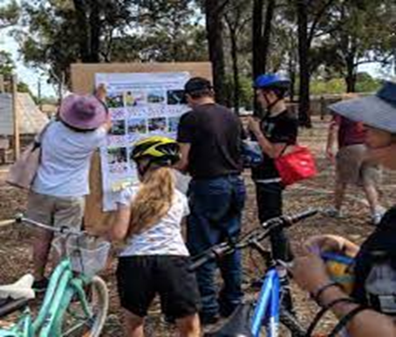
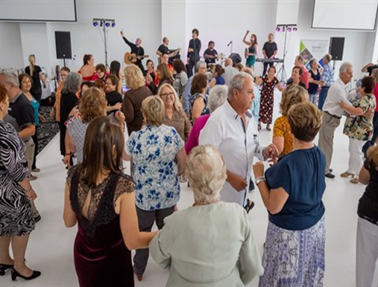
Fairfield - A unique and diverse city
As per census 2021, parents and home builders/makers in the age group 35-49 make up 18.4% of population, a young workforce as well as empty nesters and retirees at 13%.
This makes it more challenging to streamline the services to meet the need of the community.

Slide 8
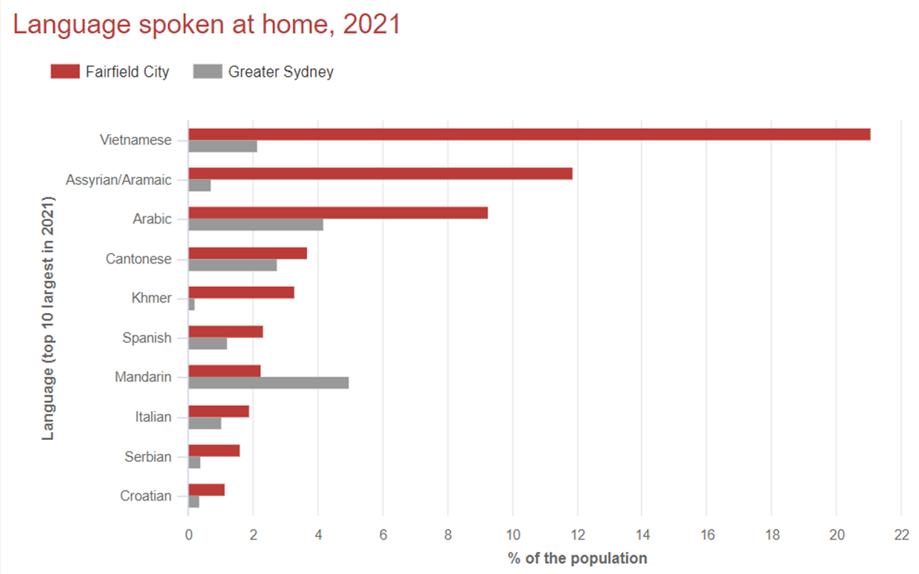

Slide 9
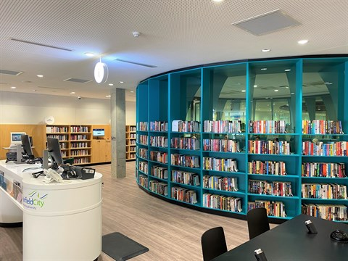
Fairfield City Open Libraries
Provides services through 5 branches
Whitlam Library Cabramatta
Bonnyrigg Library
Fairfield Library
Smithfield Community Library
Wetherill Park Library

Slide 10
Fairfield City Open Libraries
Library Support to the Community
Language is a major influence on people’s wellbeing and we support the community providing collections in major languages for their information and recreational needs.
Library provides bilingual books, especially for children, in helping the community keep up with their family language(s) and to promote literacy in more than one language.
Fairfield City Open Libraries (FCOL) currently has LOTE collection in 12 languages and 5 formats including print books, audio books, magazines, DVDs, e-books, e-audio books, streaming and online resources.

Slide 11
Fairfield City Open Libraries
Community Language Collections – Books, Fiction and Non-Fiction, including children.
Arabic
Assyrian
Bosnian
Cambodian
Chinese
Croatian
Italian
Russian
Serbian
Spanish
Thai
Vietnamese

Slide 12
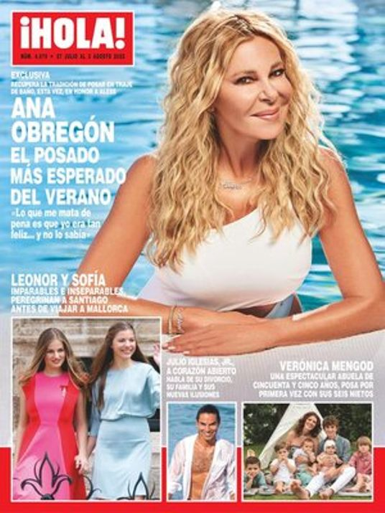
Fairfield City Open Libraries
Community Language Collections – Magazines
Arabic
Bosnian
Cambodian
Chinese
Croatian
Italian
Serbian
Spanish
Vietnamese

Slide 13
Fairfield City Open Libraries
Community Language Collections – DVDs
Arabic
Bosnian
Cambodian
Chinese
Croatian
Italian
Russian
Polish
Serbian
Spanish
Thai
Vietnamese

Slide 14
Fairfield City Open Libraries
Community Language Collections – VOX Books for Children
Picture books, chapter books, and non-fiction titles with audio recordings that capture the attention of children and makes learning and literacy development fun.
Arabic-English
Mandarin-English
Spanish-English

Slide 15
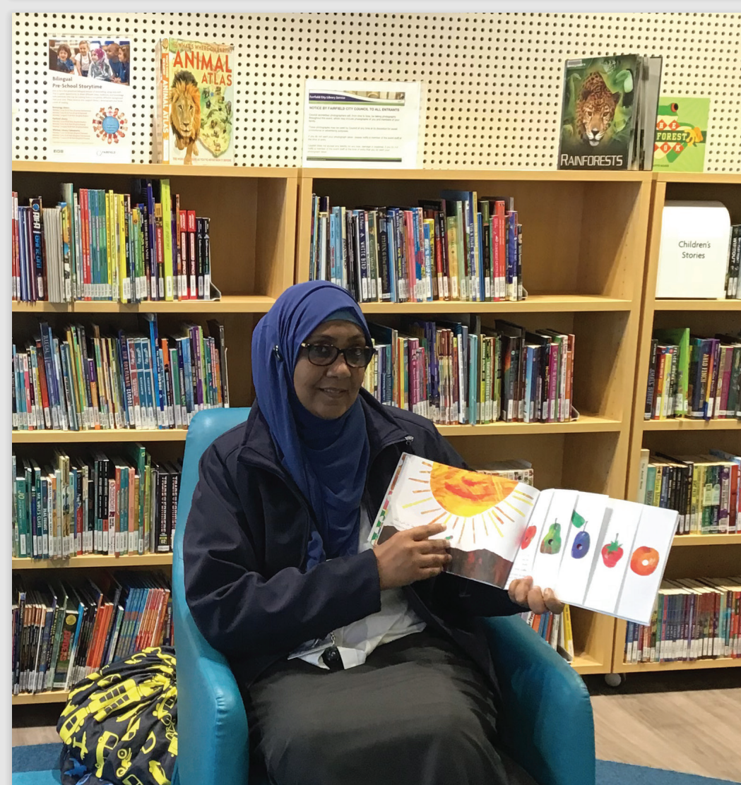
Fairfield City Open Libraries
Bilingual Storytime
We conduct bilingual storytime in Vietnamese, Arabic and Mandarin Chinese and this encourages literacy in multiple languages
Bilingual storytimes are inclusive, and they allow children to embrace culturally and linguistically diverse stories, songs and languages

Slide 16
Fairfield City Open Libraries
Connected with the Community: Working with Local Authors
Connecting with local authors and acquiring works with local relevance
Lao children's books by Vicky Rattanavong
Spring Rolls and Vegemite Sandwiches by Pho Yann, an English language story with the experience of a Vietnamese migrant child, giving the cultural flavour to the experience.

Slide 17
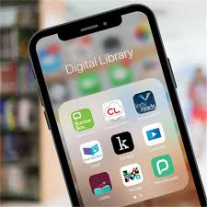
Fairfield City Open Libraries
Digital Library – take your library wherever you go
We offer a rich collection of eResources

Slide 18
Digital Library
LOTE Online for Kids! – Bilingual Picture Books
1500 digital books in 60 languages
Choice of picture books in LOTE and English
Great resource, well-received by playgroups and we have promoted to families at storytime.

Slide 19
Digital Library
CloudLibrary – eBooks
Arabic
Chinese
Italian
Russian
Serbian
Spanish
Vietnamese

Slide 20
Digital Library
cloudLibrary – LOTE eBooks

Slide 21
Digital Library
indyreads – Online Library 24/7
indyreads eContent management platform. Thanks to SLNSW for providing access to eBooks and eAudio to Public Libraries.

Slide 22
Digital Library
hoopla
Simultaneous access to multiple formats – eBooks, eAudio, Comics including streaming of music, movies and TV series

Slide 23
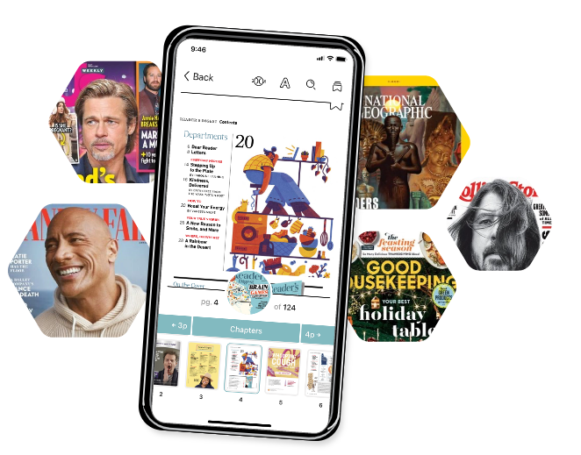
Digital Library
Libby – eMagazines
Arabic
Chinese
Italian
Russian
Serbian
Spanish
Vietnamese

Slide 24
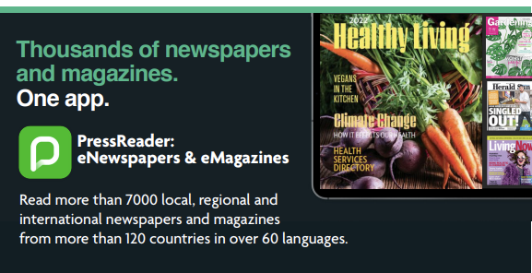
Digital Library
PressReader – eMagazines & eNewspapers
Arabic
Chinese
Italian
Spanish
Vietnamese

Slide 25
Digital Library
Kanopy – Streaming Movies
Arabic
Chinese
Croatian
Italian
Russian
Spanish
Thai

Slide 26
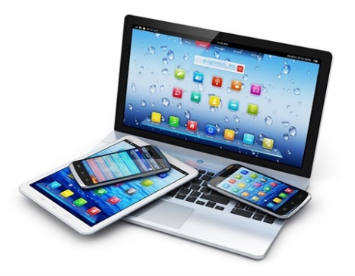
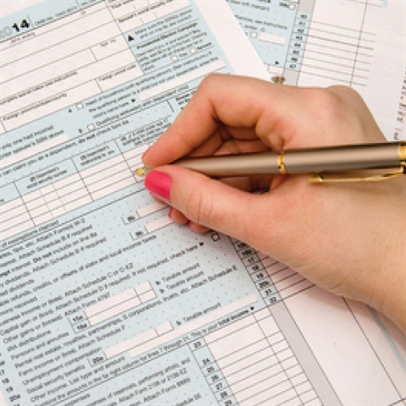
Tech Support – Smart Bar, PC Smart & Form Filling Assistance
We provide one-on-one Smart Bar sessions with a library expert in setting up library apps on device.
PC Smart sessions provide help with basic computer & internet issues.
Form Filling provides help with documents and online forms e.g. Centrelink, Passport, rental applications

Slide 27
Fairfield City Open Libraries
Requests
Suggestions for purchase
Inter-Library Loans
State Library Multicultural Bulk Loan Service

Slide 28
Connect with Open Libraries
Telephone: 9725 0333 Fax: 9728 4617 Talk to one of library staff on LiveChat!
Email (General enquiries): libraryenquiries@fairfieldcity.nsw.gov.au Email (Home Library Enquiries): hls@fairfieldcity.nsw.gov.au
Leave us a comment or give us feedback
Fairfield City Open Libraries PO Box 21 Fairfield NSW 1860

