Slide 1
Science Fiction and Fantasy specialists
sf@galaxybooks.com.au

Slide 4
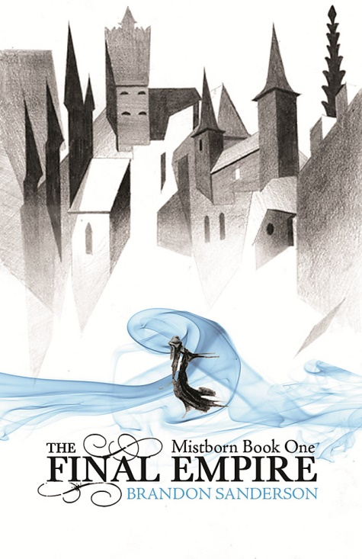

Slide 5
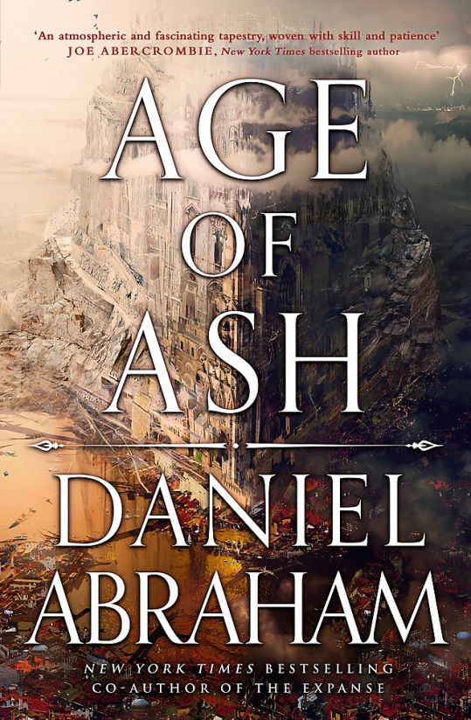
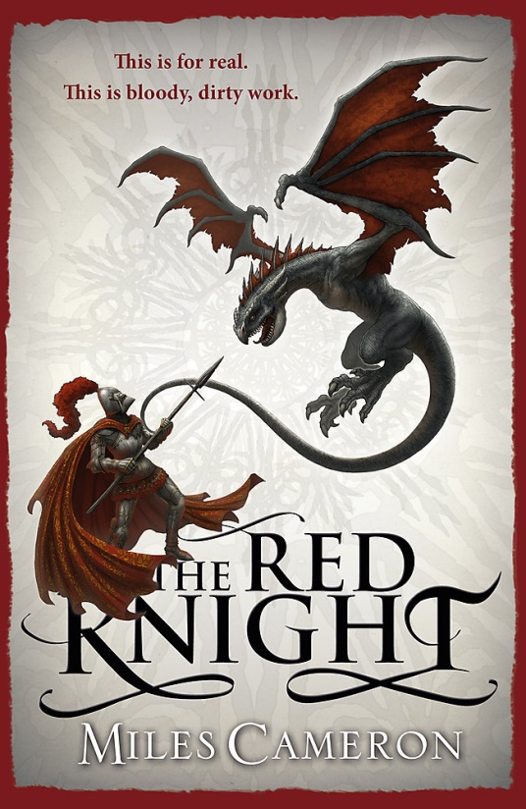

Slide 6
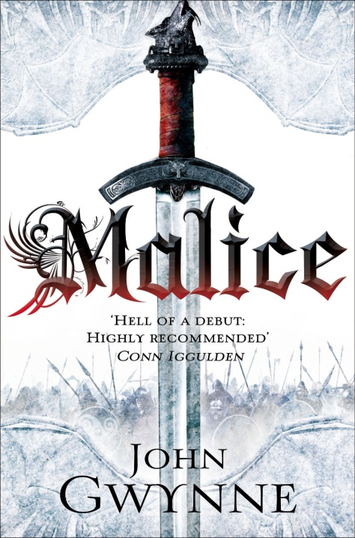
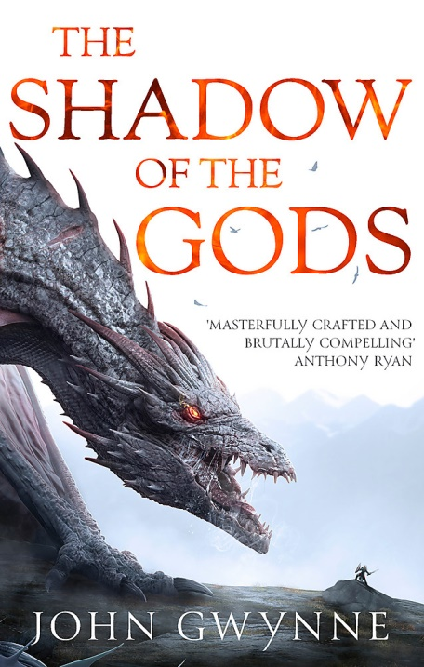

Slide 7
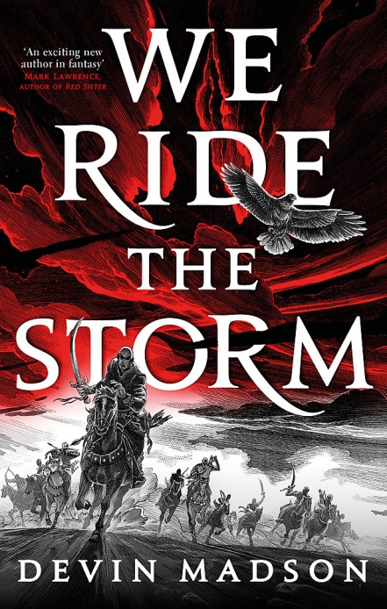

Slide 8
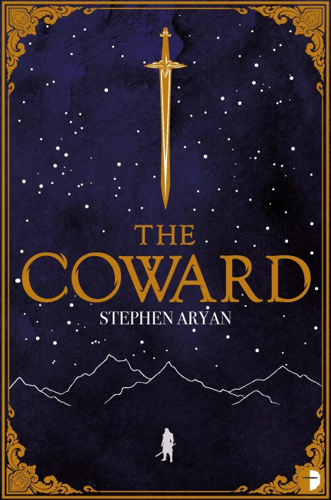
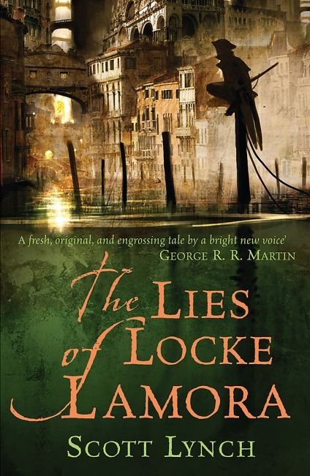
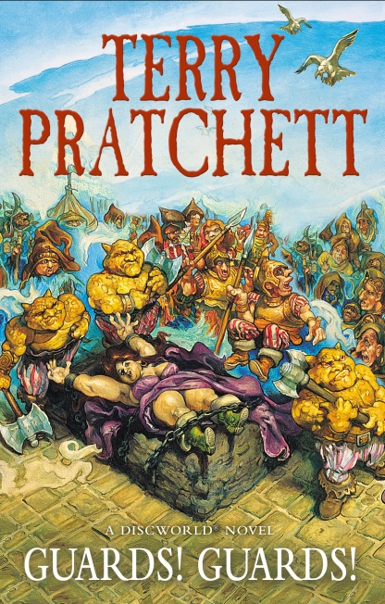

Slide 9
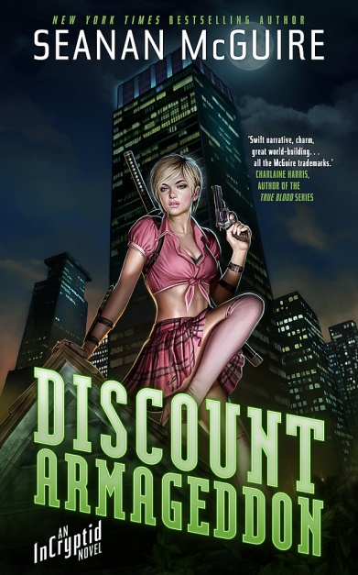

Slide 10
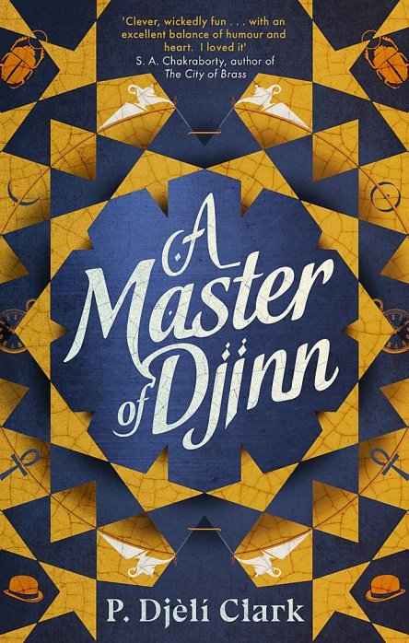

Slide 11
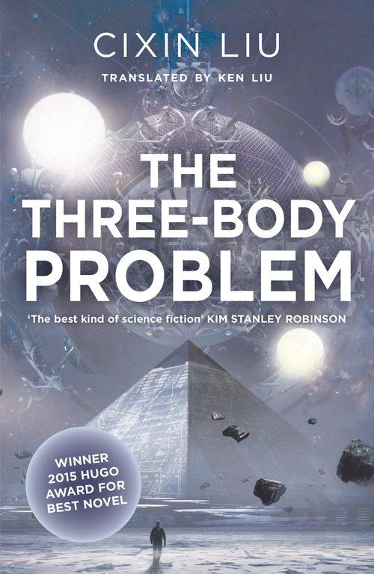

Slide 12
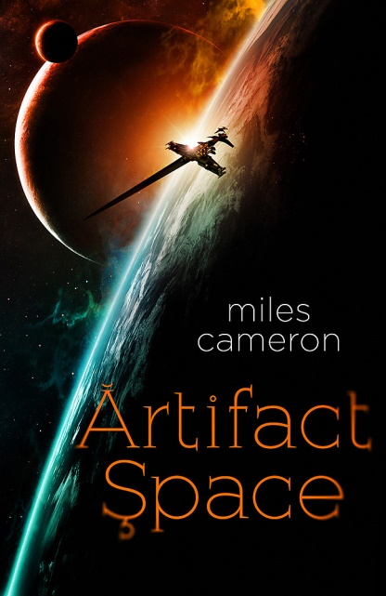

Slide 15
Where to find out about the best new Science Fiction and Fantasy
Awards
Hugo/Astounding
Nebula
Locus
World Fantasy Award
Aurealis
British SF/Fantasy Award
Arthur C Clarke
Philip K Dick
David Gemmell
Locus Magazine
Io9
Tor.com
Goodreads lists
Thenerddaily.com
Epicreads.com (YA)
Streaming platforms
Publisher newsletters/social media

Slide 16
Science Fiction and Fantasy specialists
sf@galaxybooks.com.au

