Slide 1
Multicultural spotlight

Slide 2
Acknowledgement of Country
“I would like to acknowledge the Wallumedegal people who are the Traditional Custodians of this Land. I would also like to pay respect to the Elders both past and present of the Eora Nation and extend that respect to other Aboriginals present.”

Slide 3
Our Community
Notes:
North Western suburbs of Sydney , 10km from Sydney GPO
Bounded by Hornsby, Kuringai, Parramatta, Hunters Hill and Lane Cove

Slide 4
Our Community
Largest group is parents and homebuilders in the 35-49 age range (22.6%), with the young workforce (25-34) close behind (18.4%)
49.5% of the population speak a language other than English at home
49% of the population were born overseas
There are 77 languages other than English spoken in homes

Slide 5
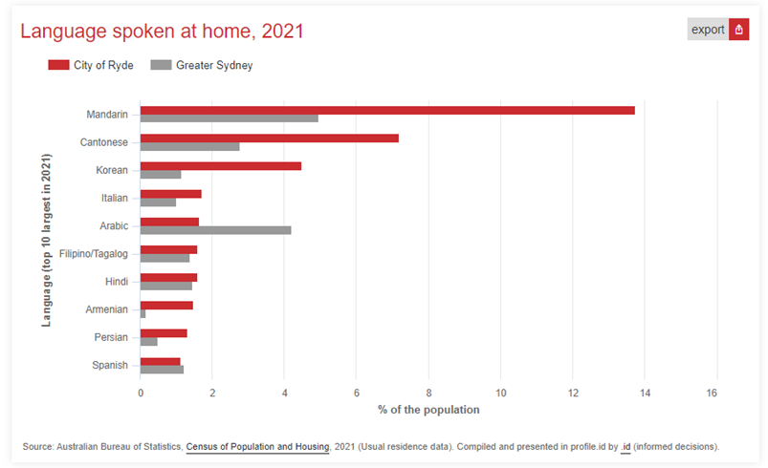
Top ten languages spoken at home
Notes:
Since 2016, the Italian and Armenian populations have reduced in size, with the growing populations being Mandarin and Filipino/Tagalog

Slide 6
Our Library Service
5 libraries
Central branch at Ryde, Eastwood, West Ryde, North Ryde and Gladesville
Home Library Service
We have taken the NSW Multicultural Services Benchmark and assessed our library service against it to determine where and how there is room to improve.
Notes:
Looking at services, collections and programs.

Slide 7
Collections
English Language Books, Large Print, Talking Books
DVDs, CDs
Magazines
Chinese
Korean
Tamil
Other languages requested as Bulk Loans from the State Library as required

Slide 8
eCollections with Multicultural Content
PressReader
IndyReads
LOTE Online for Kids

Slide 9
Library Programs
Children & Youth Programs
Story time and Rhyme Time sessions for Children under 5
School holiday activities
1000 Books Before School
Multicultural & Volunteers programs
Adults and Seniors programs
History services and programs

Slide 10
Multicultural Programs
Multicultural Librarian role established in Nov 2019
Strategic plan to organise programs to promote literacy, social inclusion, lifelong learning and cultural diversity with a focus on CALD community
Build relationships and develop partnerships with local community groups, NGOs and government bodies to deliver community information talks and workshops
Notes:
Since 2019 there has been more effort to foster relationships with the local community groups and organisations to deliver community information talks in English and other languages

Slide 11
Multicultural Programs
Literacy Programs - English Conversation Classes
Held weekly during school terms – very popular
Delivered online on Zoom during March 2020 - April 2022
Resumed face to face in May 2022
Digital Inclusion Programs
TSS classes in English, Cantonese, Mandarin and Korean
Bilingual webpage to promote Tech Savvy Seniors Program
Notes:
ECC – both Beginners and Intermediate
The Intermediate class booked out within 2 hours.
One exciting reward from this program was 2 Ukrainians who were new to the country, started in the beginners class. After a couple of classes they were able to find employment.

Slide 12
Multicultural Programs
Community Talks in LOTE languages
Topics on health/employment/legal/environment/tax
Delivered face to face or online
Local history bi-lingual talks on Chinese Market Gardeners
Workshops to promote lifelong learning and wellbeing
Migrant employment workshop
Chinese classical poetry workshop

Slide 13
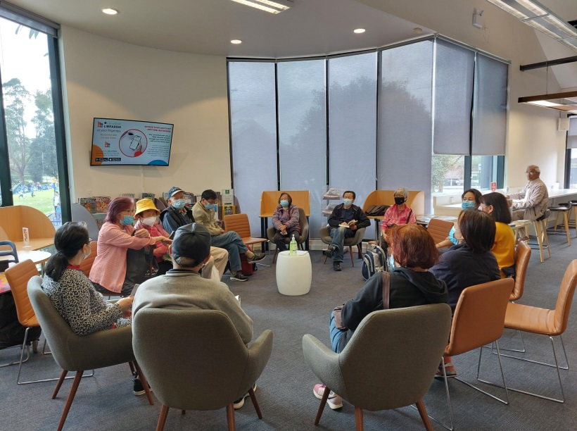
Multicultural Programs
Celebrate cultural diversity
Lunar New Year
Cultural art & craft exhibition
Cultural calligraphy workshop
Community focus groups
Chinese Classical Poetry Group
Chinese Readers Group
Notes:
Both groups are held monthly and respectively at WR and Eastwood Library

Slide 14
Promotion
Use of Council social media networks such as Facebook and Instagram
Local newspapers – programs and events advertised in English as well as Korean and Chinese language papers
Marketing Emails sent to borrowers who opt in.
Bi-lingual Flyers/posters in the library
Multimedia notices in the library
Notes:
Social media limited, but looking to introduce our own library Facebook page where we will have more control.
Korean and Chinese laminated mage

Slide 15
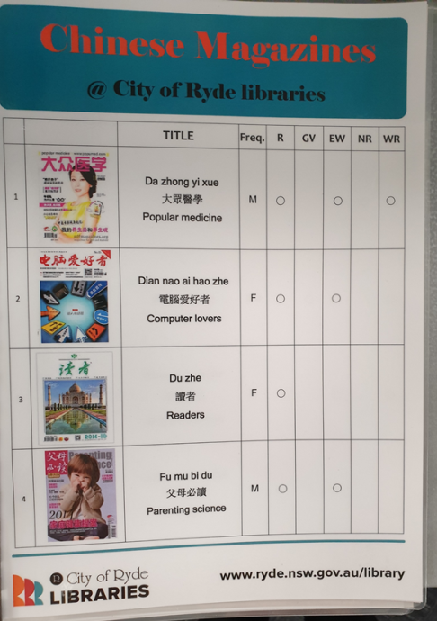
Promotion
Notes:
Laminate lists of Chinese magazines at each branch to show what we hold and where

Slide 16
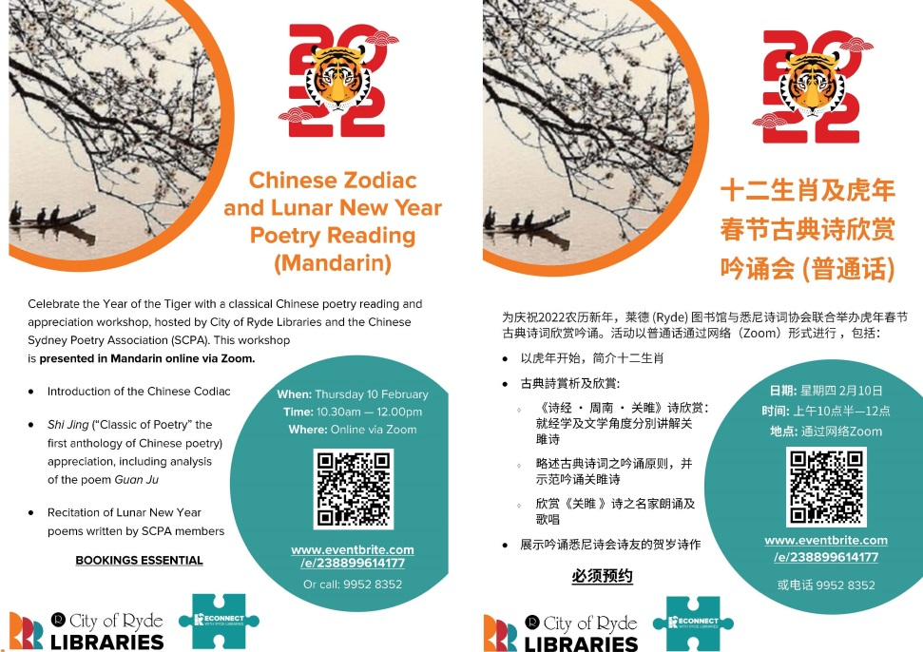
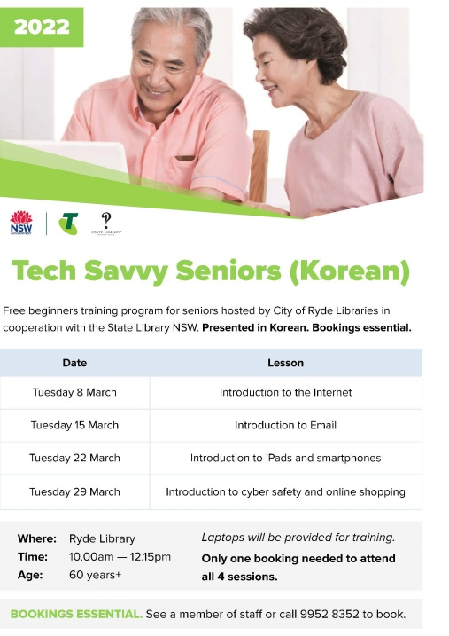
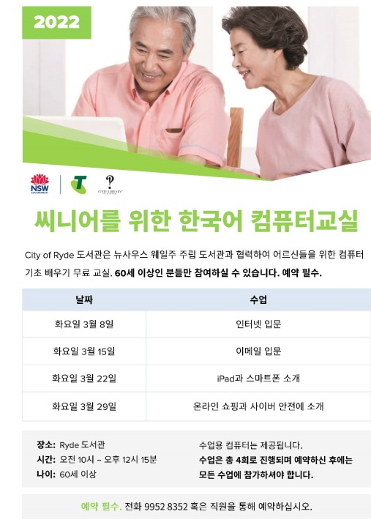
Promotion
Notes:
Bilingual Flyers examples: Chinese classical Poetry Reading workshop & TSS classes in Korean

Slide 17
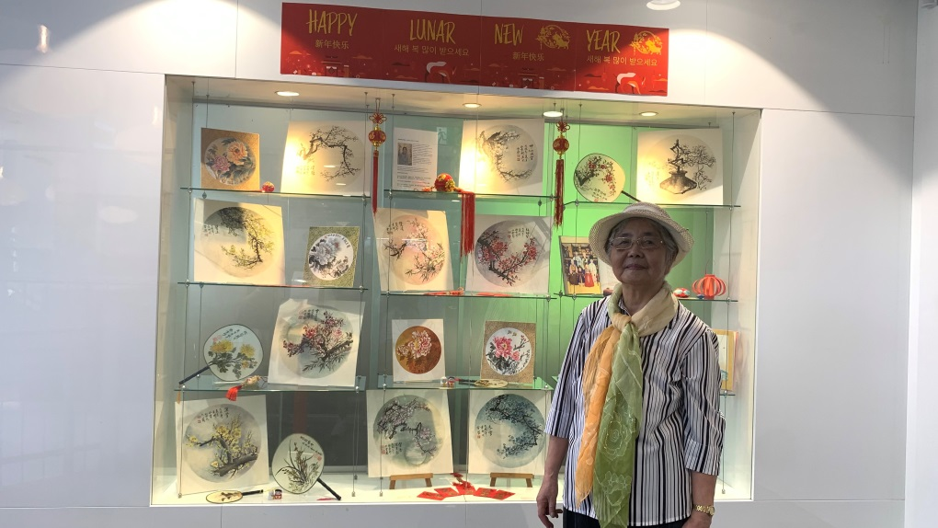
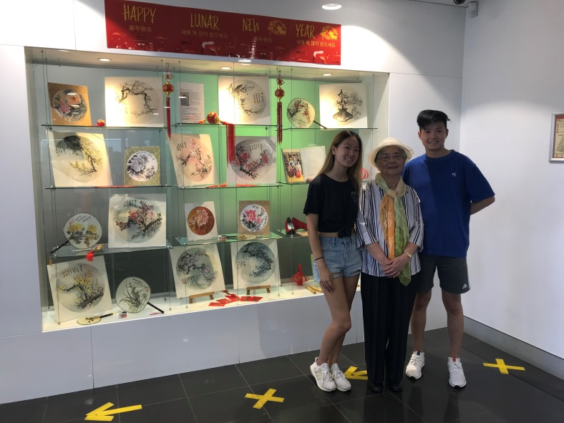
Promotion
Notes:
Traditional Chinese painting Exhibition to celebrate Lunar New Year – Artist: Subin Xu and her twin grandchildren visiting Ryde Library

Slide 18
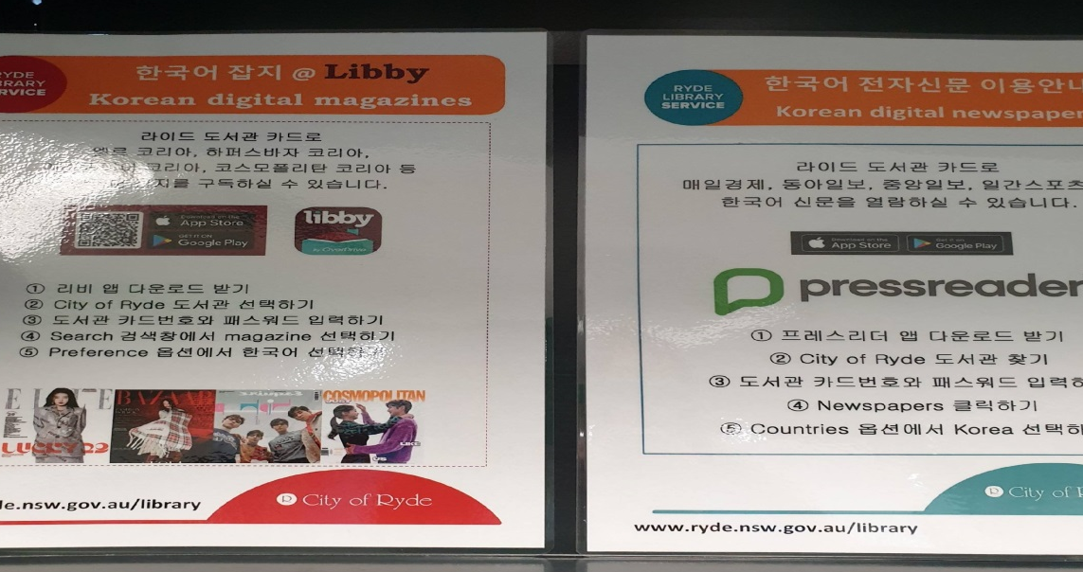
Promotion
Notes:
New book lists for Korean books
Laminated promotion of emagazines and newspapers in Korean

