Slide 1
Science Fiction and Fantasy specialists
sf@galaxybooks.com.au

Slide 3
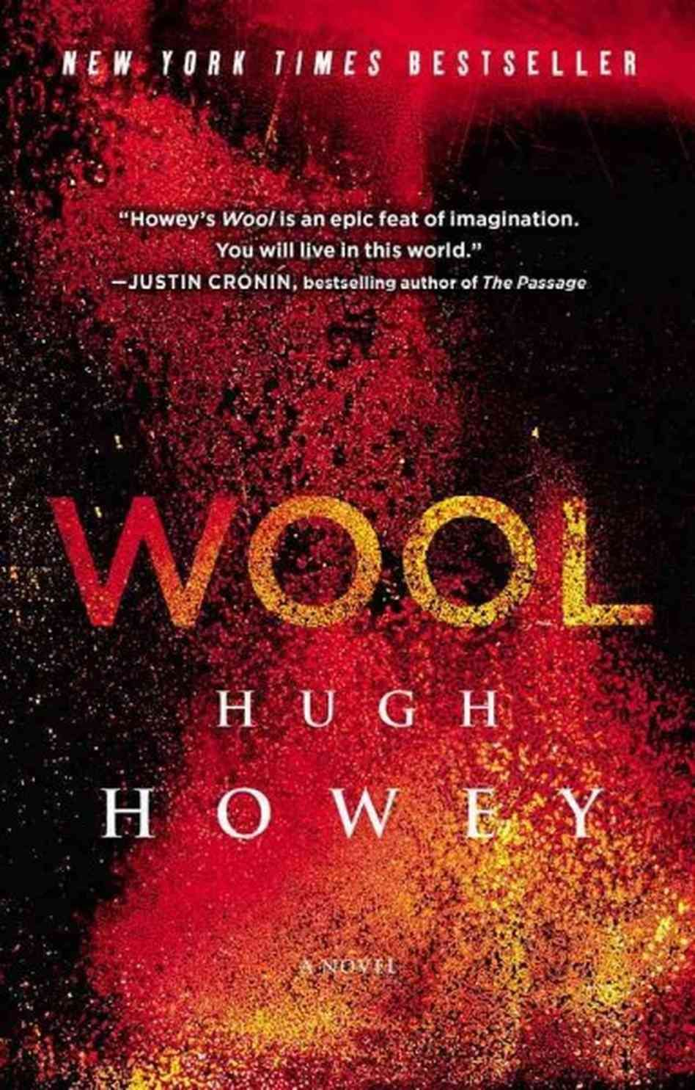

Slide 4
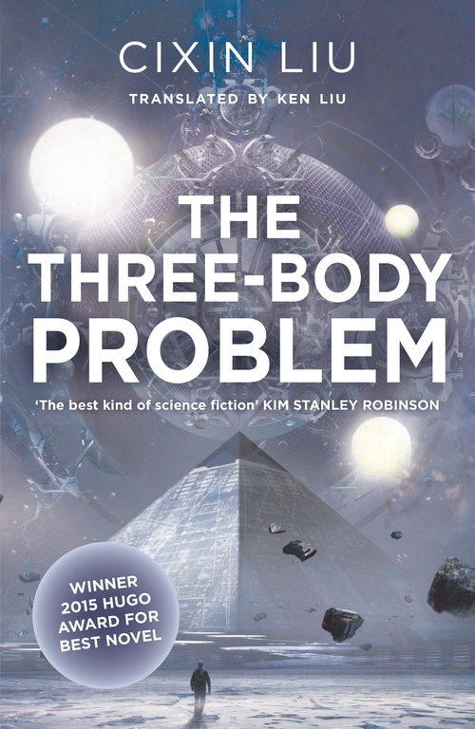

Slide 5
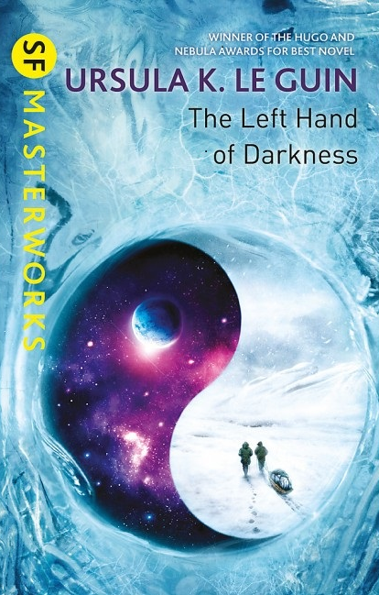
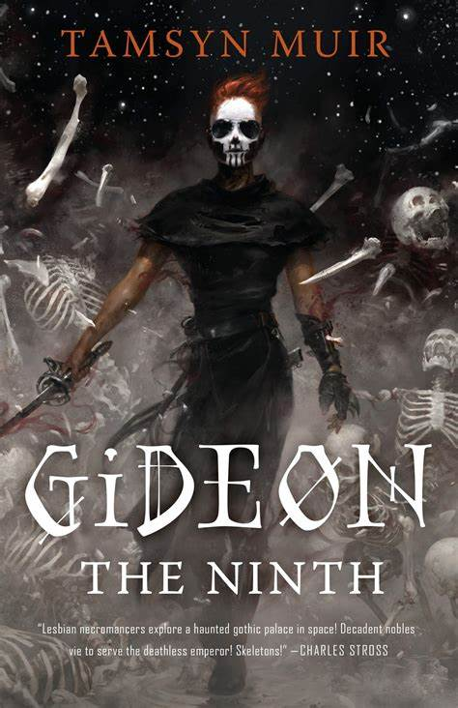

Slide 6
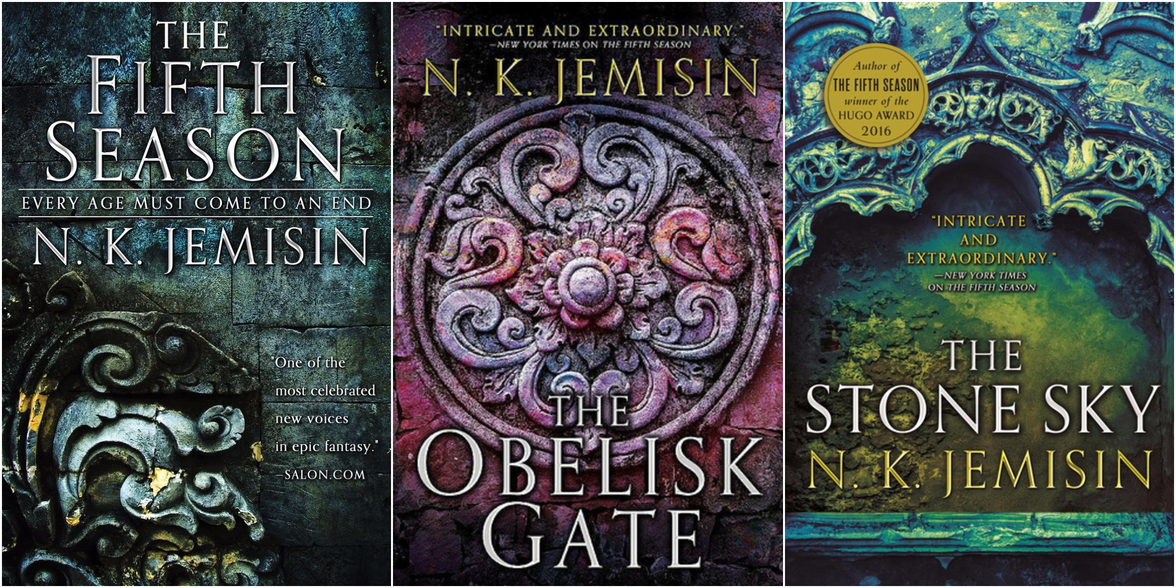

Slide 7
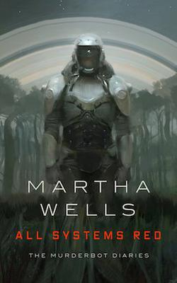

Slide 8
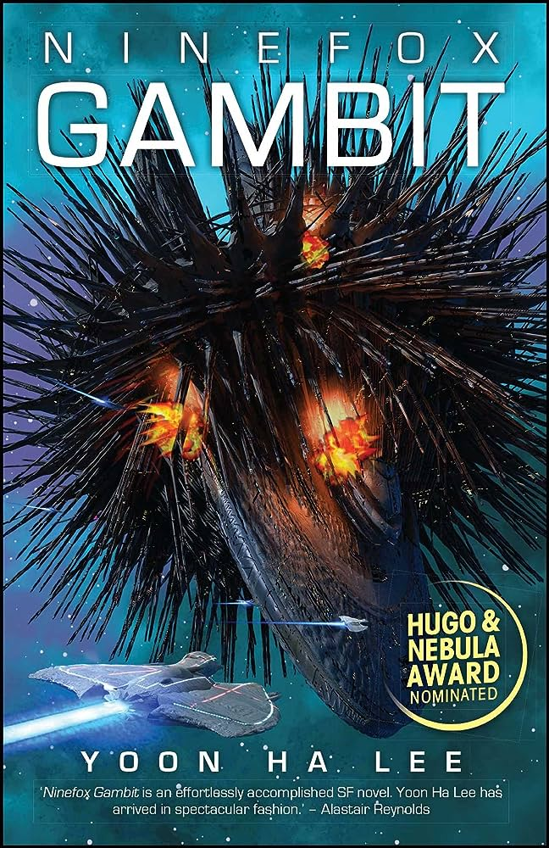

Slide 10
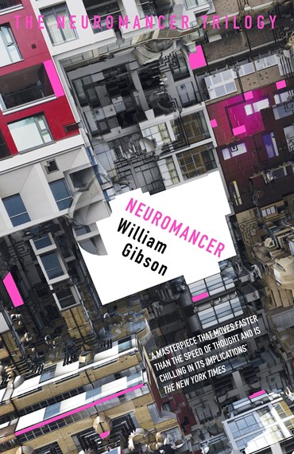
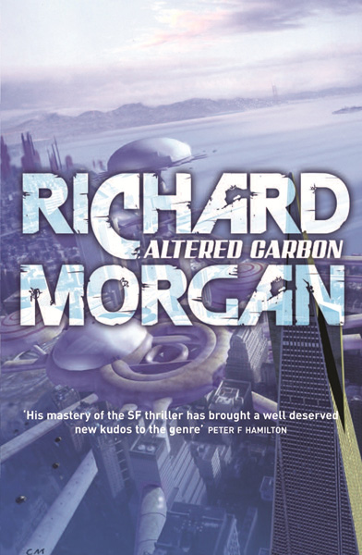

Slide 11
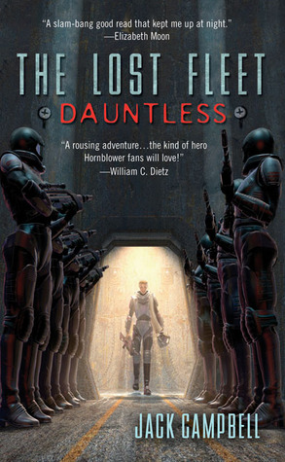

Slide 14
Where to find out about the best new Science Fiction and Fantasy
Awards
Hugo/Astounding
Nebula
Locus
World Fantasy Award
Aurealis
British SF/Fantasy Award
Arthur C Clarke
Philip K Dick
David Gemmell
Locus Magazine
Io9
Tor.com
Goodreads lists
Thenerddaily.com
Epicreads.com (YA)
Streaming platforms
Publisher newsletters/social media

Slide 15
Science Fiction and Fantasy specialists
sf@galaxybooks.com.au

